Slide 1

Micro Credit Defaulter Project
Submitted By:- Ojasav Sahu
Internship :- 23

Slide 2
Table of Contents :-
Introduction
Analytical Problem Framing
Analysis
Statistical Analysis of the Data
Pre-Processing
Visualization
Treating of the Outliers
Balancing the Data
Checking the Random State
Hyper Parameter Tuning
Conclusion
Limitations and scope for the Future

Slide 3
Introduction :-
A Microfinance Institution (MFI) is an organization that offers financial services to low-income populations. MFS becomes very useful when targeting especially the unbanked poor families living in remote areas with not much sources of income. The Microfinance services (MFS) provided by MFI are Group Loans, Agricultural Loans, Individual Business Loans and so on.
Many microfinance institutions (MFI), experts and donors are supporting the idea of using mobile financial services (MFS) which they feel are more convenient and efficient, and cost saving, than the traditional high-touch model used since long for the purpose of delivering microfinance services. Though, the MFI industry is primarily focusing on low-income families and are very useful in such areas, the implementation of MFS has been uneven with both significant challenges and successes.
Today, microfinance is widely accepted as a poverty-reduction tool, representing $70 billion in outstanding loans and a global outreach of 200 million clients.

Slide 4
We are working with one such client that is in Telecom Industry. They are a fixed wireless telecommunications network provider. They have launched various products and have developed its business and organization based on the budget operator model, offering better products at Lower Prices to all value conscious customers through a strategy of disruptive innovation that focuses on the subscriber.
They understand the importance of communication and how it affects a person’s life, thus, focusing on providing their services and products to low-income families and poor customers that can help them in the need of hour.
They are collaborating with an MFI to provide micro-credit on mobile balances to be paid back in 5 days. The Consumer is believed to be defaulter if he deviates from the path of paying back the loaned amount within the time duration of 5 days. For the loan amount of 5 (in Indonesian Rupiah), payback amount should be 6 (in Indonesian Rupiah), while, for the loan amount of 10 (in Indonesian Rupiah), the payback amount should be 12 (in Indonesian Rupiah)

Slide 5
Analytical Problem Framing:-
Here our dataset has 209593 rows and 37 columns, using this dataset we will be building the model followed by training the data and then finally the model is tested by using 67% of the training data and 33% of the testing data.
Since we have no null values from the dataset during the data collection stage, we can expect outliers and un-realistic values for certain variables.

Slide 6
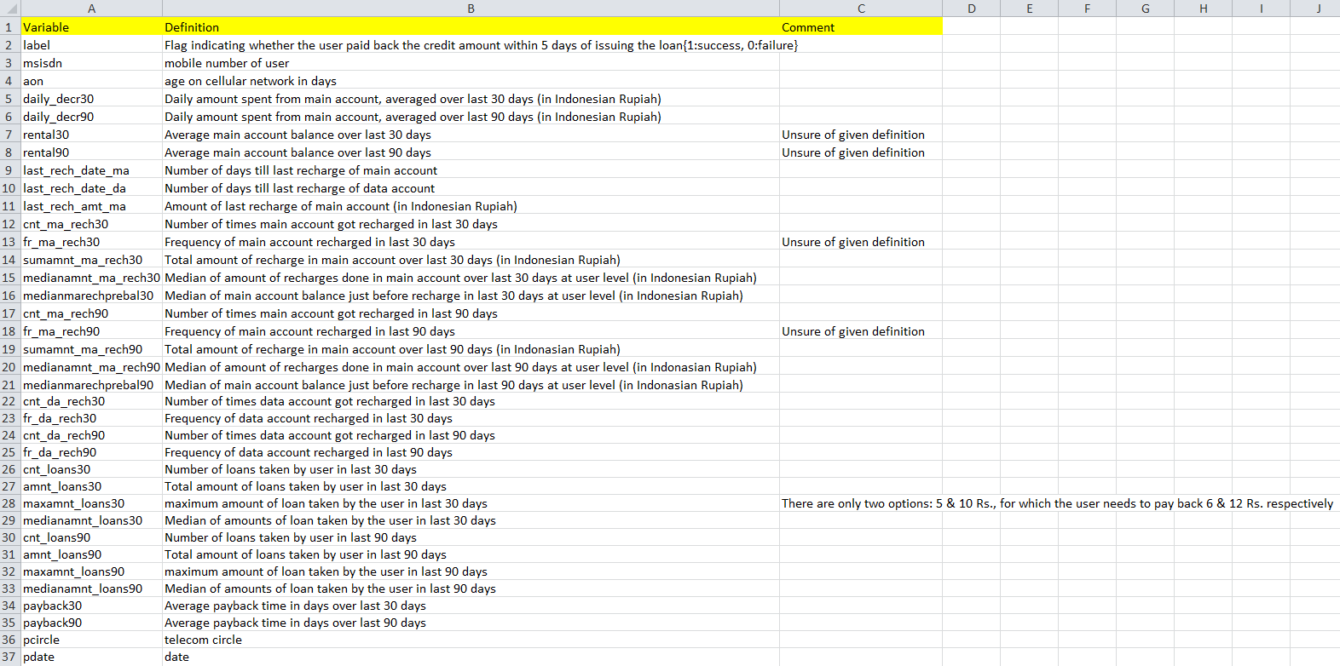

Slide 7
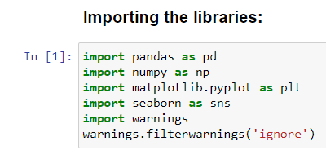
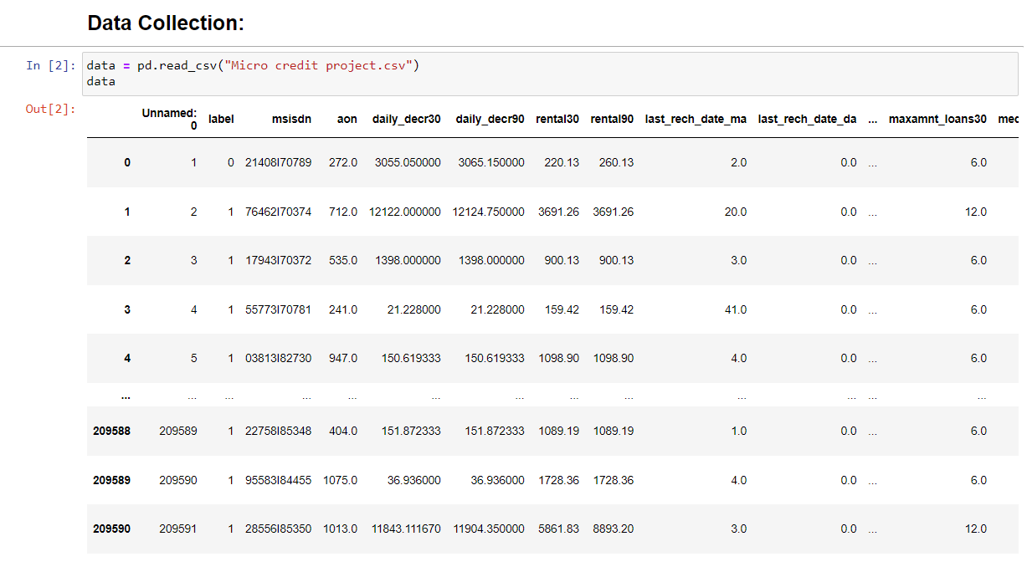
Analysis:-
Here we have the features with “Float and int” datatypes except the feature “pdate” which is “object” datatype and from this feature multiple new features are to be extracted and then further they are changed to the appropriate datatypes.

Slide 8
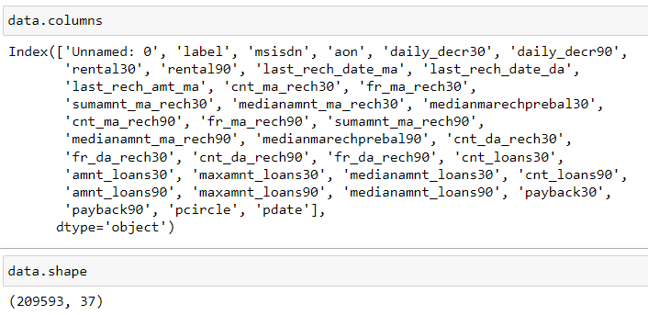
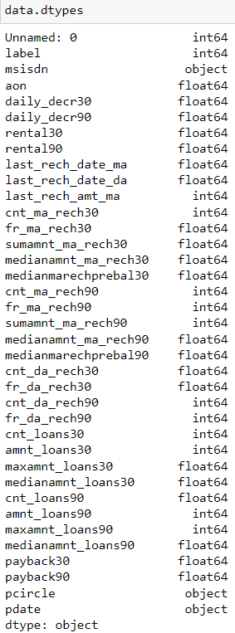
I have the features with “Float and int” datatypes except the feature “pdate” which is “object” datatype.

Slide 9
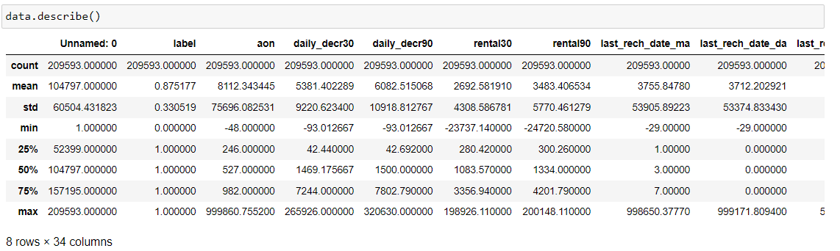
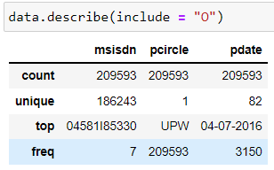
Statistical Analysis of the Data
Data has few columns in which the difference between mean and the standard deviation is more and, in few columns, it is less and is appropriate that few columns has mean value higher than standard deviation and also there are few columns in which standard deviation is higher than the mean value and also we can see that statistical analysis of the object datatype columns also in which the unique values of the data are mentioned and also we get more information regarding the frequent values present in the data of the columns.

Slide 10

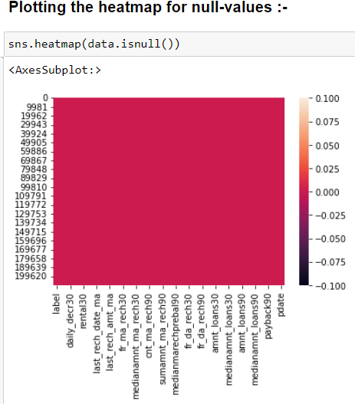

Slide 11
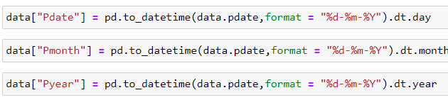
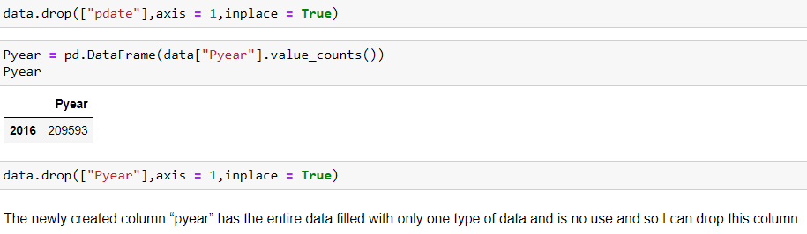
Pre-Processing
I can see that from the column “pdate”, multiple columns are extracted with the help of “pd.to_datetime”.

Slide 12
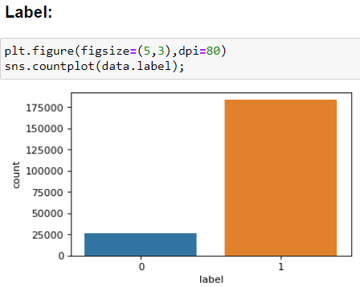
Visualization
I can see that the column has an attribute(non-defaulter) with very high count than the other attribute (defaulter).

Slide 13
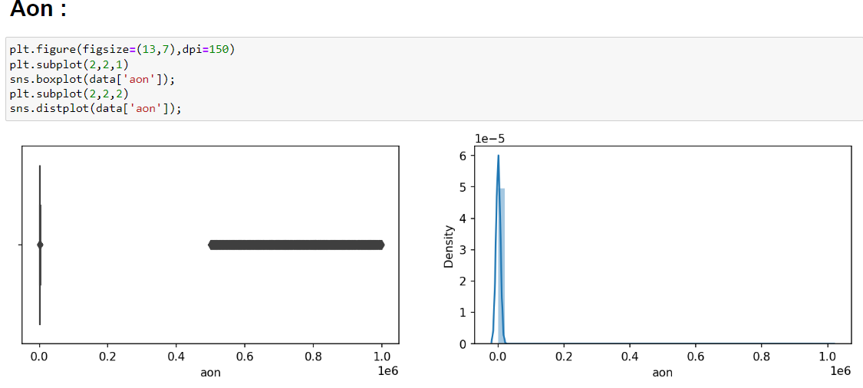
I can see that the column has many number of outliers present and also there are dense in nature and the distribution peak is also very narrow

Slide 14
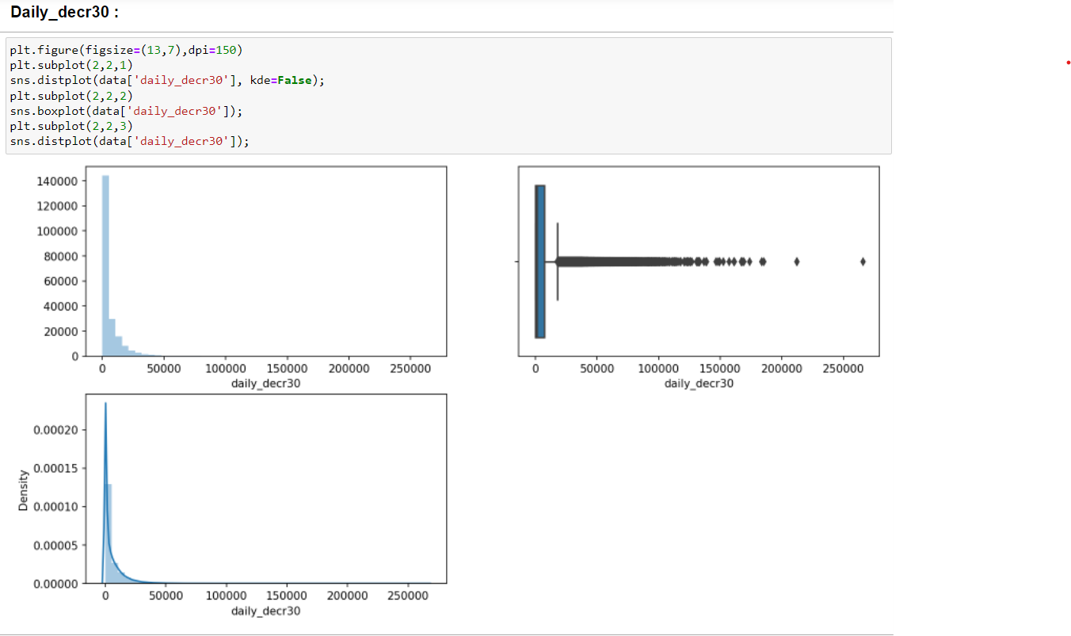
I can see that the column has many outliers and the distribution curve has the narrow peak and also has skewness.

Slide 15
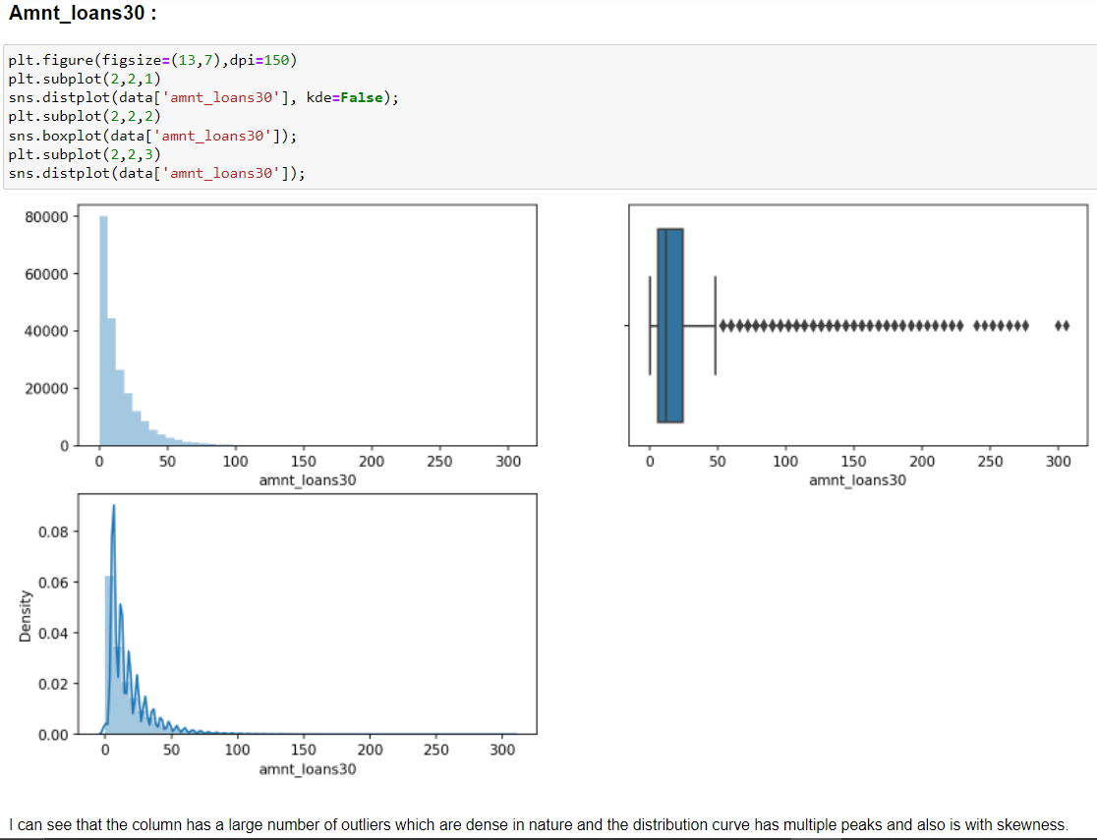
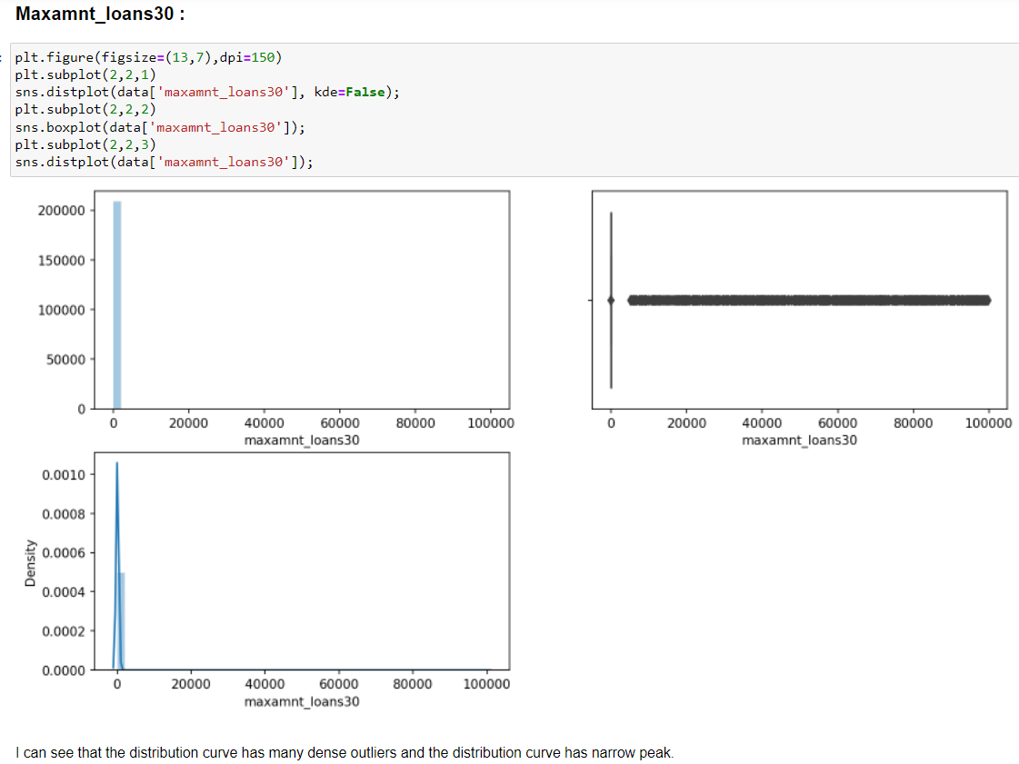

Slide 16
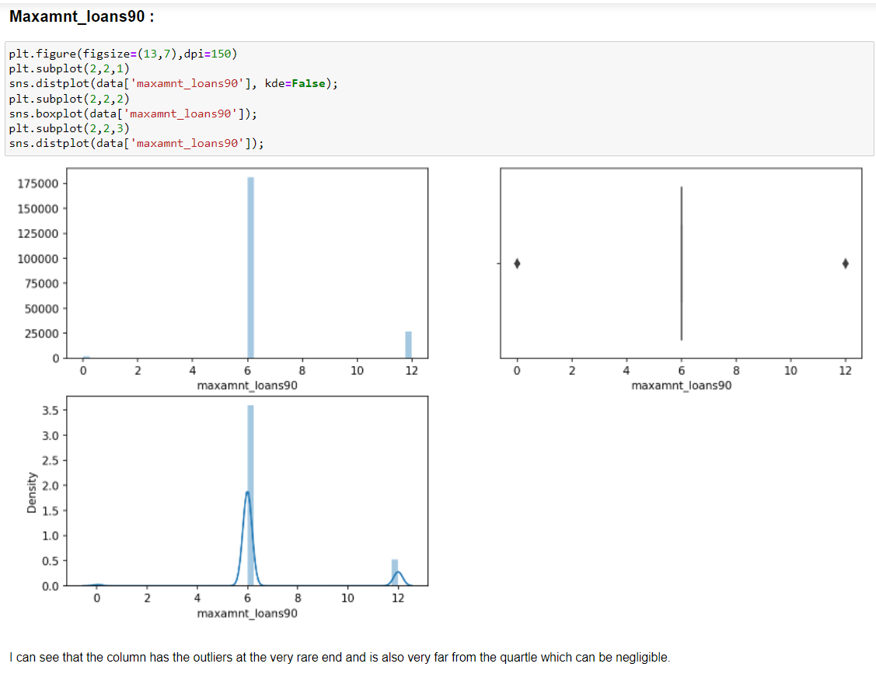
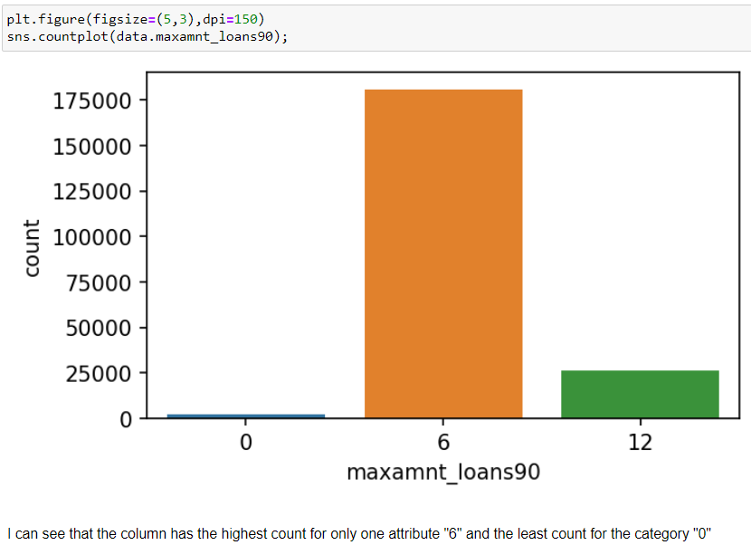

Slide 17
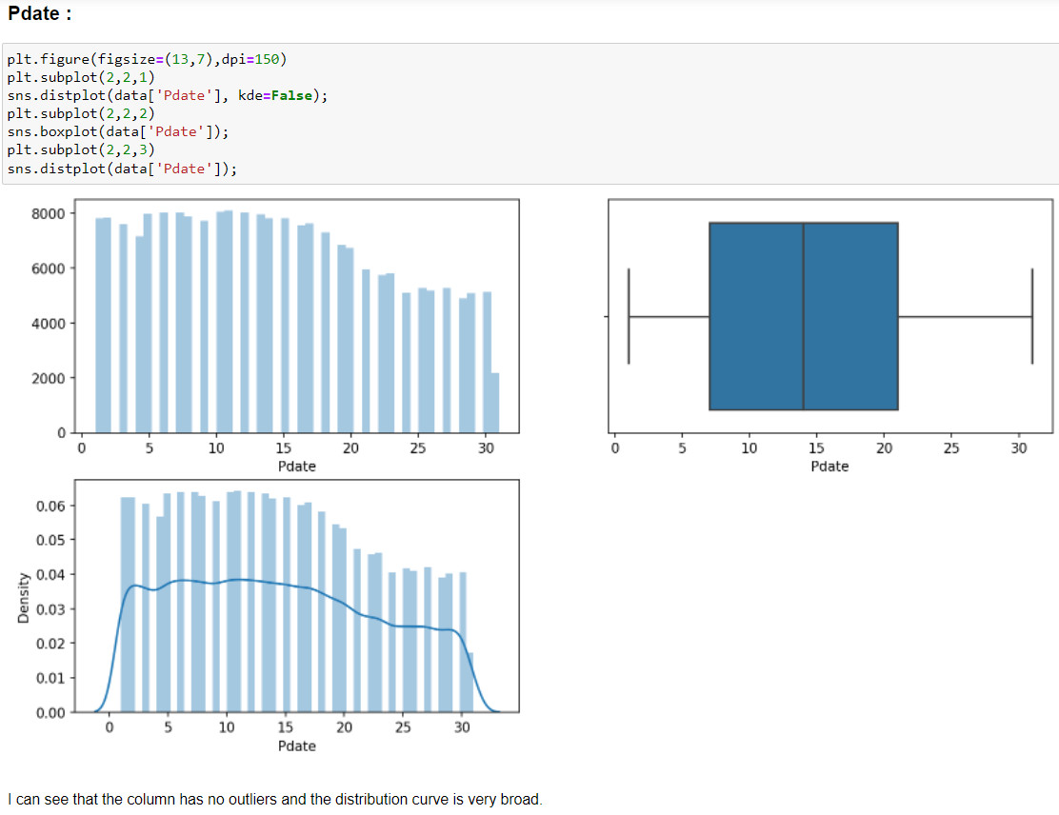

Slide 18
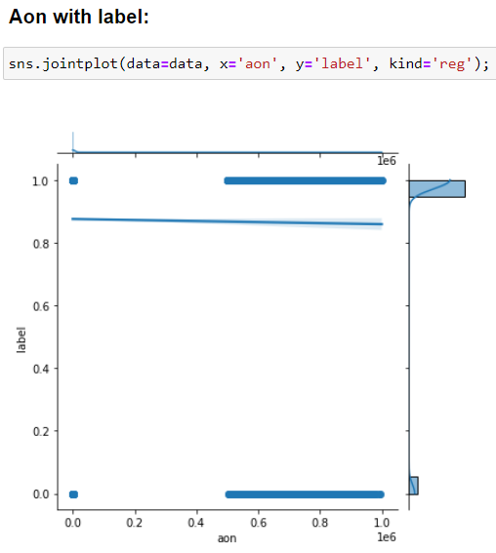
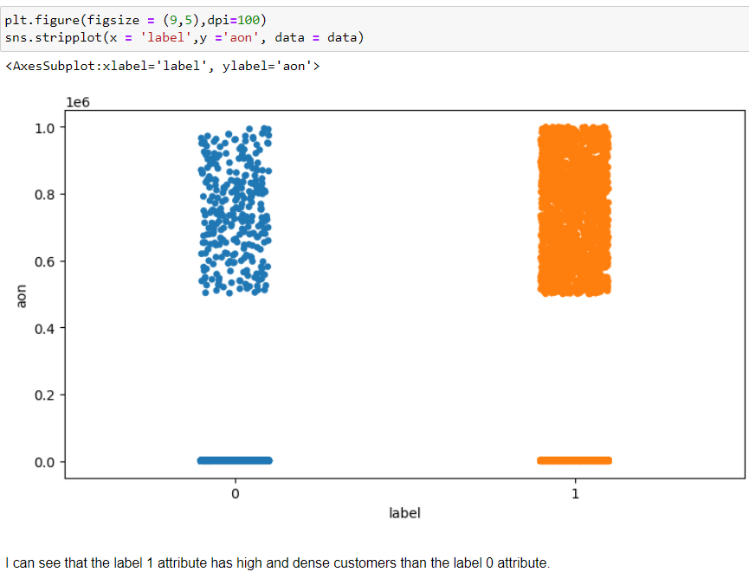
Bivariate Analysis

Slide 19
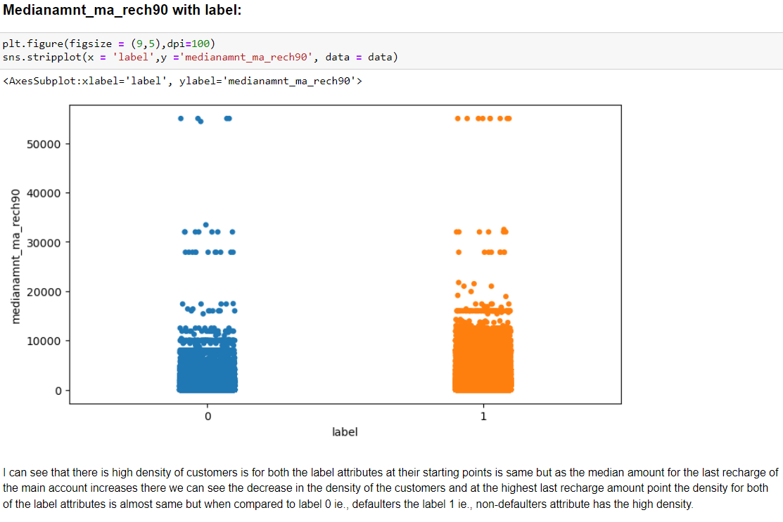

Slide 20
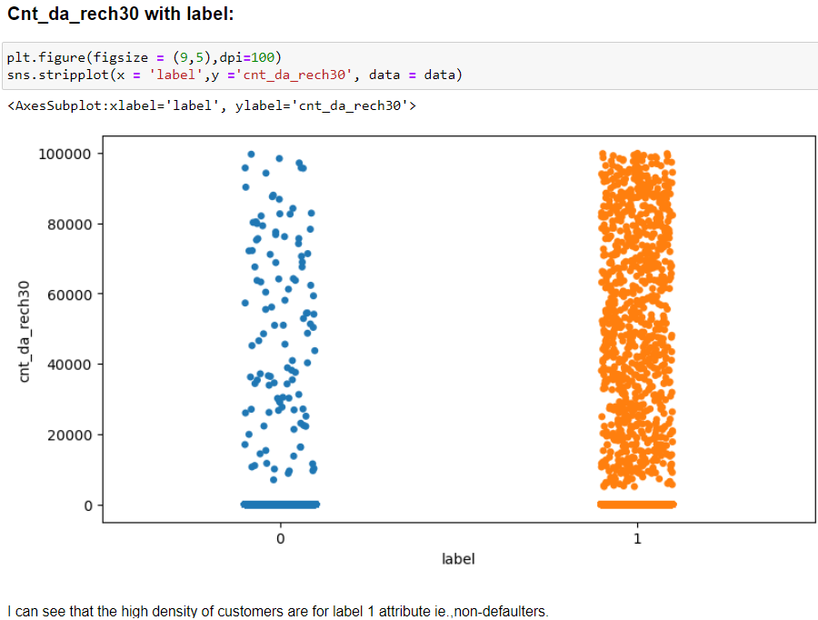
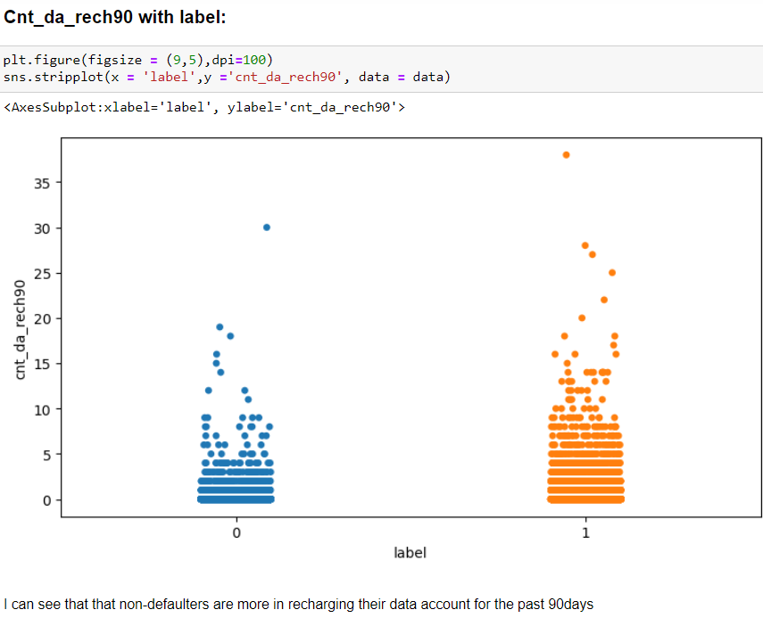

Slide 21
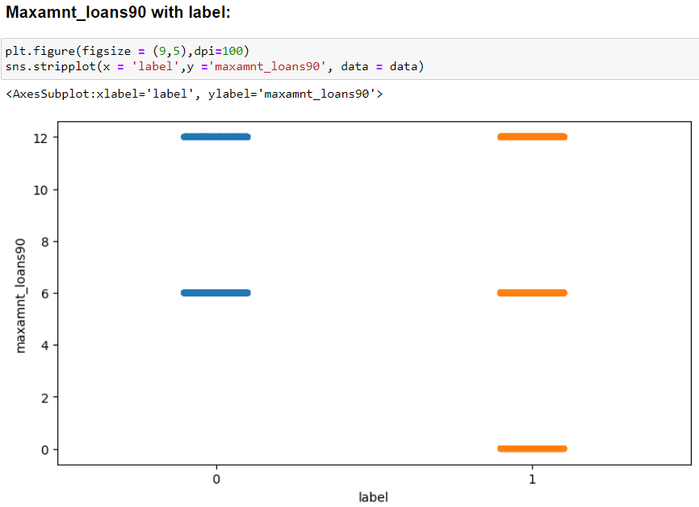
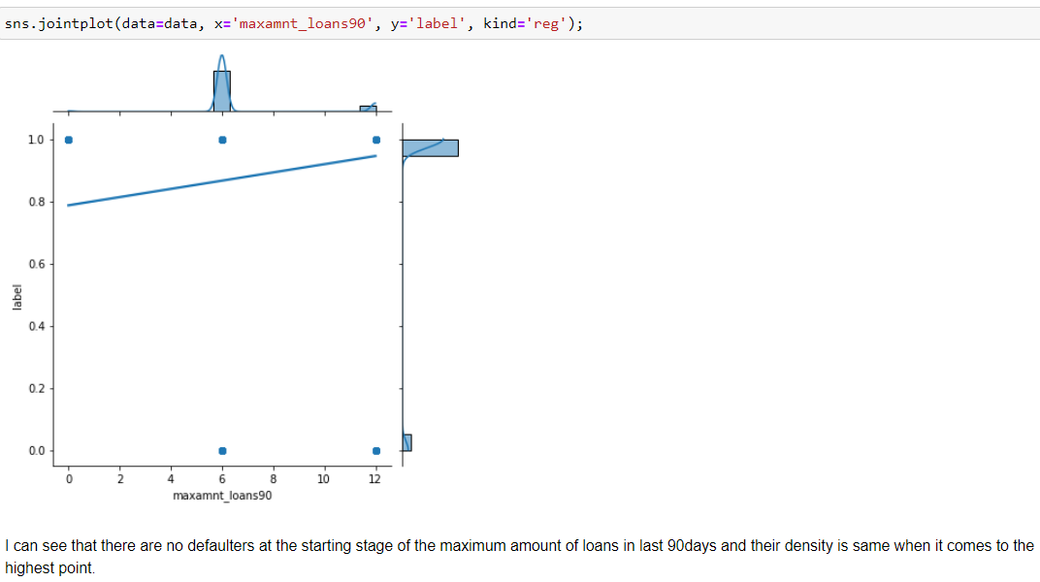

Slide 22
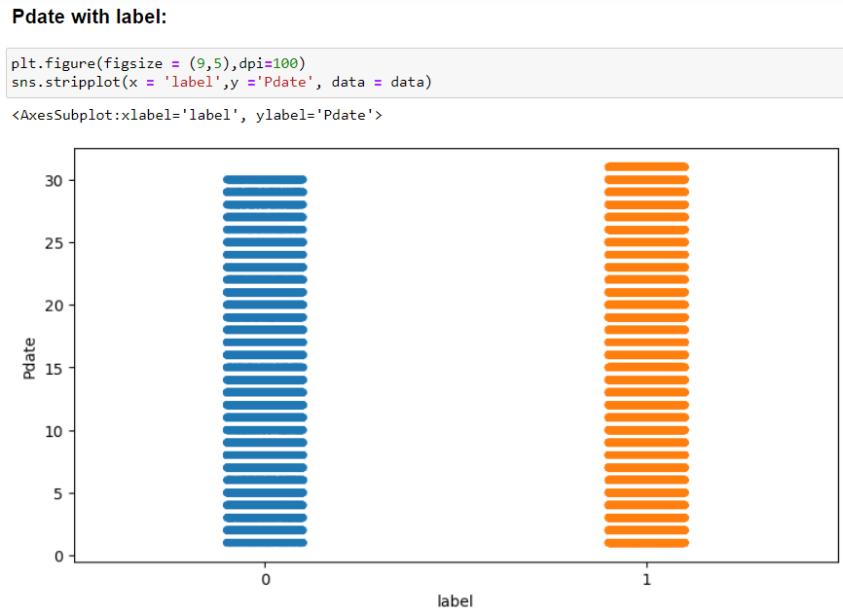
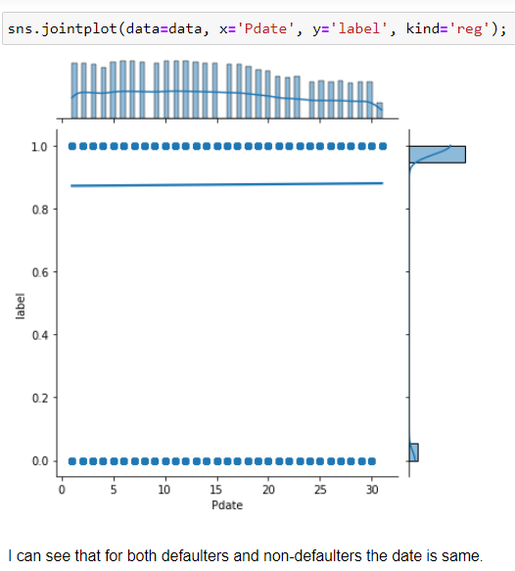

Slide 23
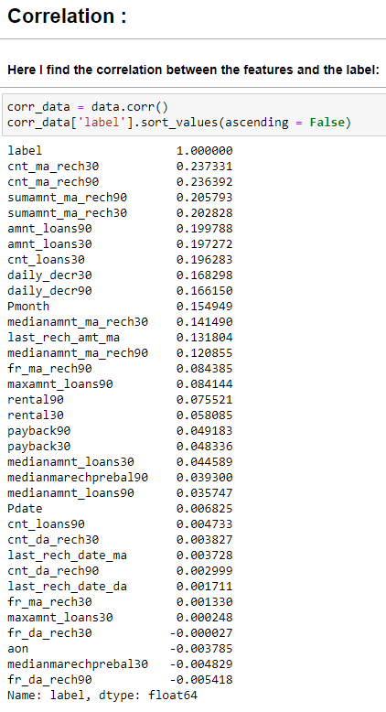

Slide 24
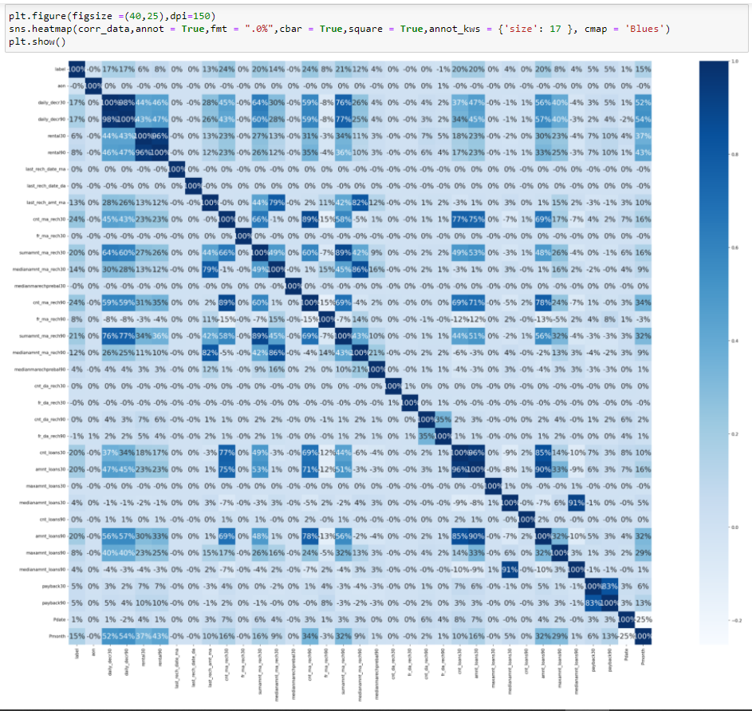
Documentation :
I can see that the maximum correlation is present between:
Medianamnt_loans90 and medianamnt_loans30
Rental_90 and rental_30
Daily_decr90 and daily_decr30
Amnt_loans90 and amnt_loans90
Cnt-loans30 and amnt_loans30 etc.
I have a lot features which with high correlation above 80%

Slide 25
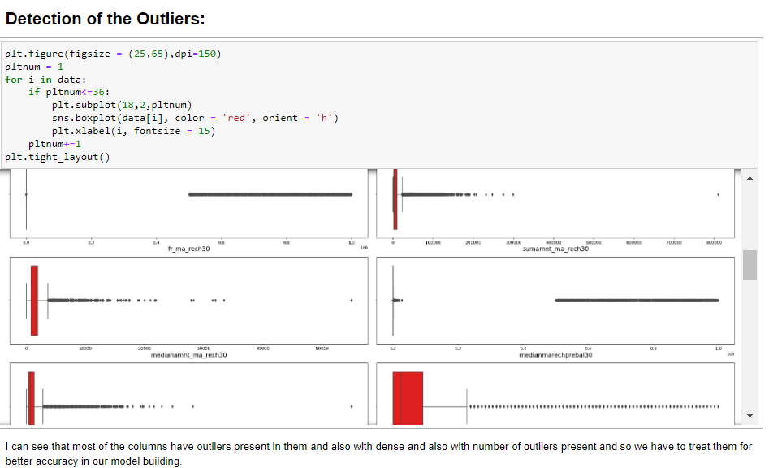

Slide 26
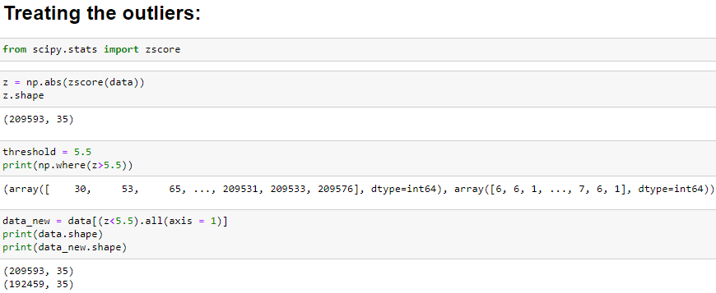
Treating the Outliers

Slide 27
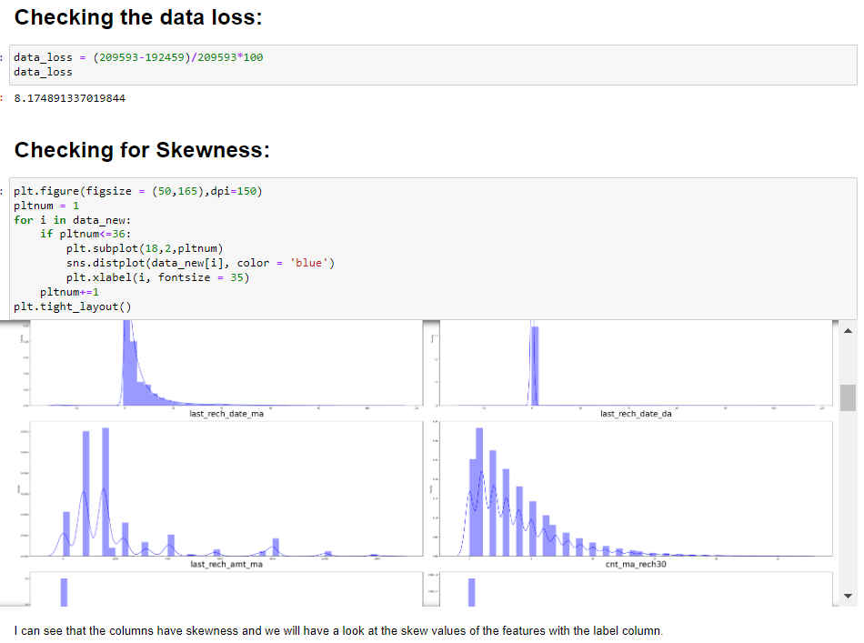

Slide 28
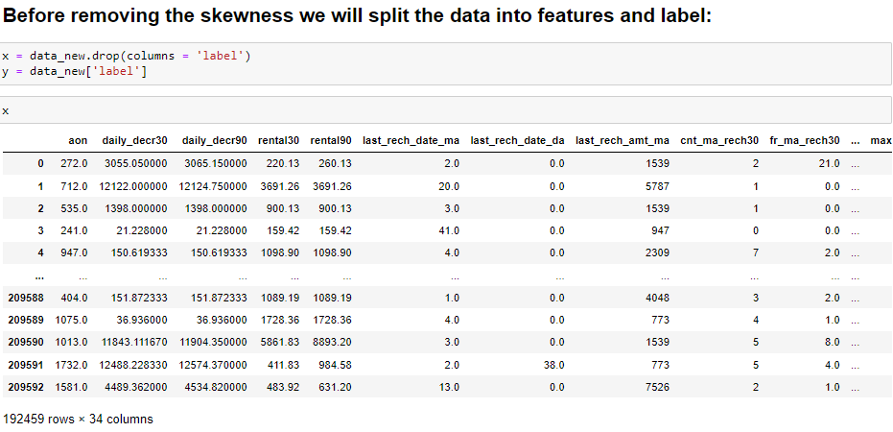
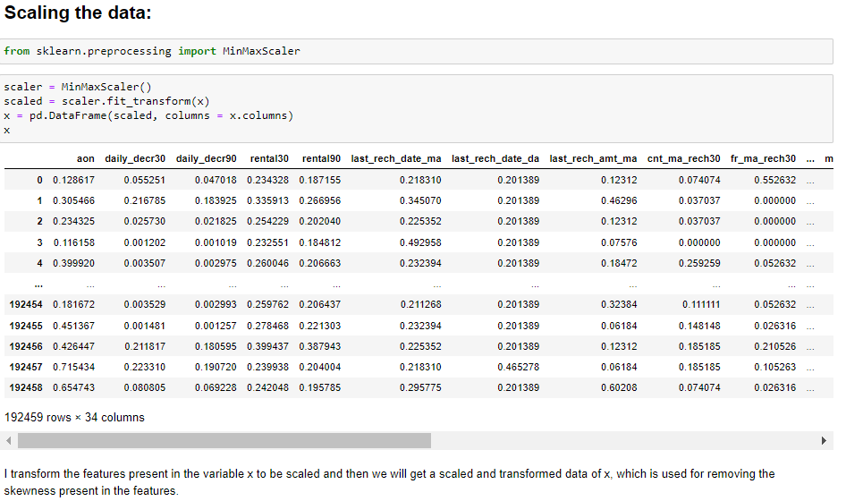

Slide 29
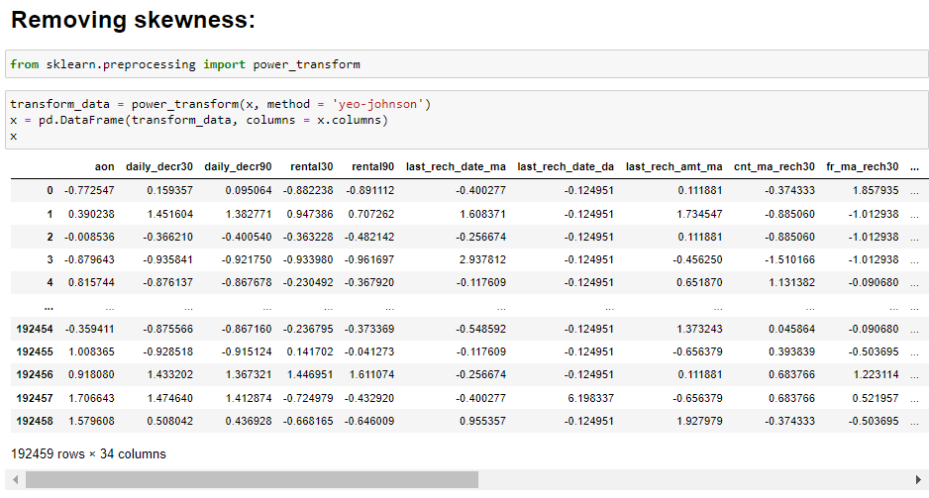
Documentation :
I can see that I have imported the “powertransform” library and passed the features present in the variable x into the powertransform and then I have removed the skewness of the data and converted into dataframe.
Now, here we have a look at the skewness of the features whether they are changed or not.

Slide 30
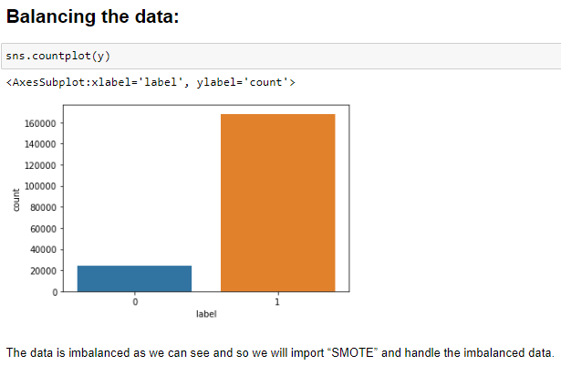
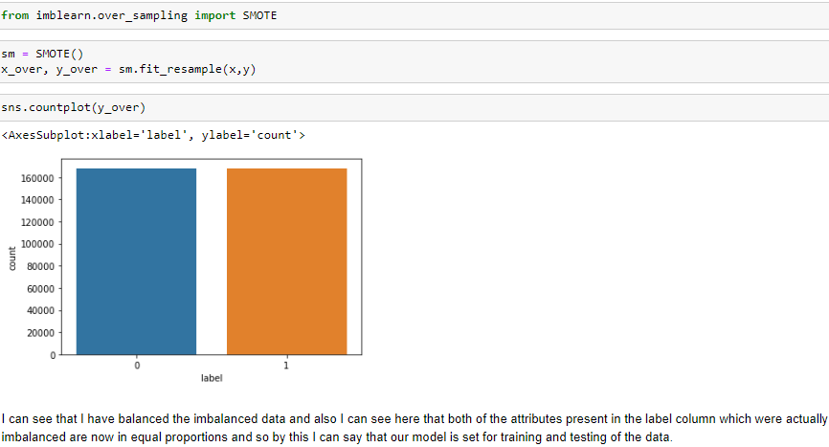
Balancing the Data

Slide 31
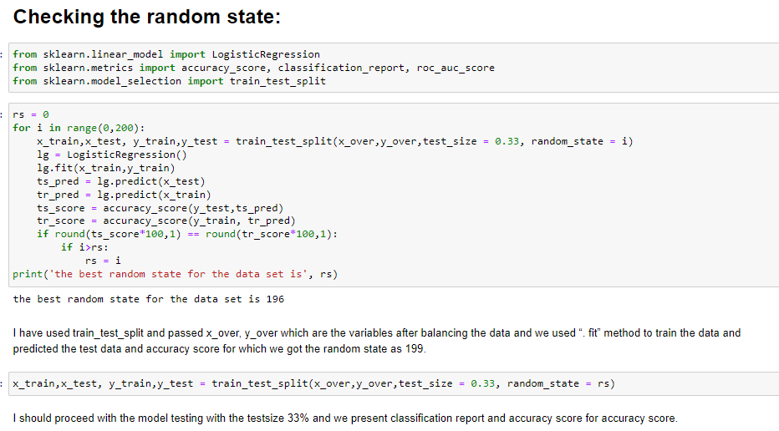

Slide 32
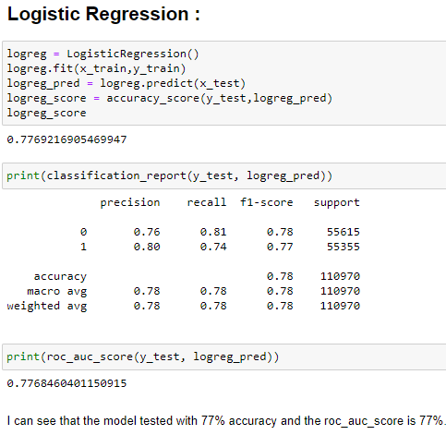
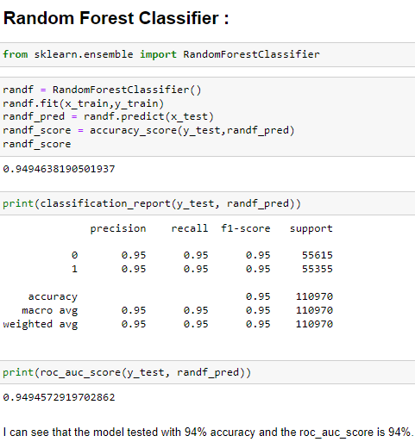

Slide 33
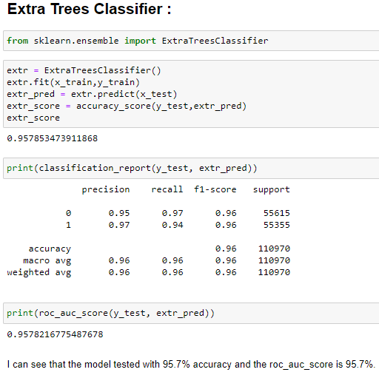
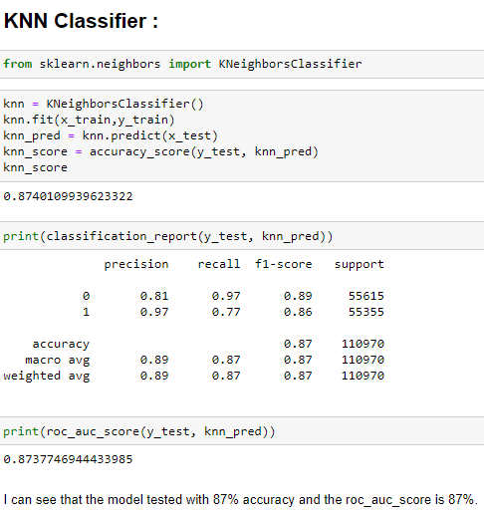

Slide 34
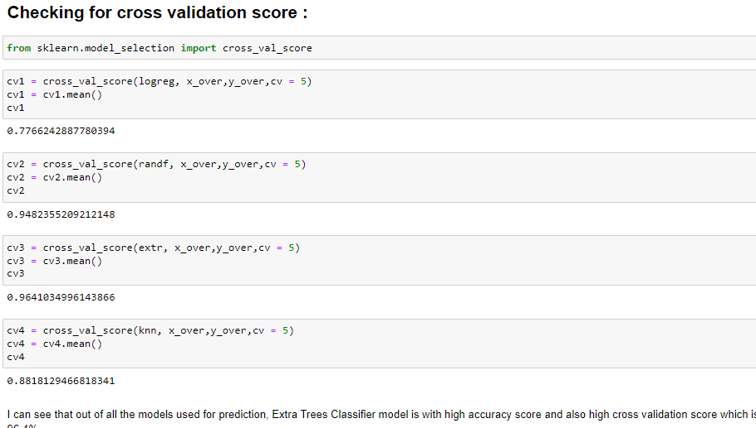
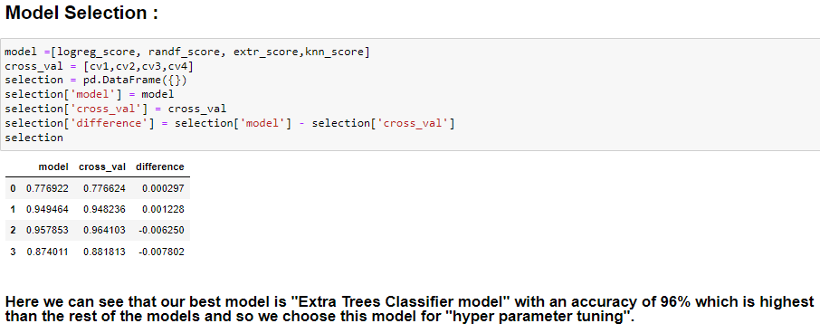

Slide 35
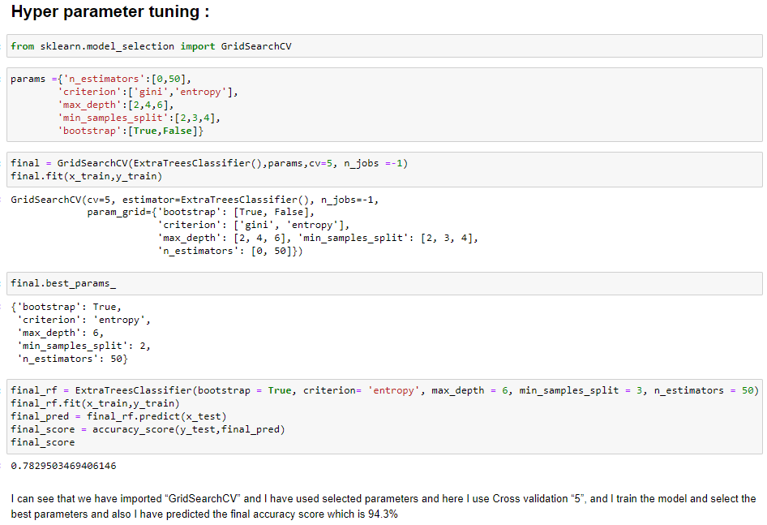

Slide 36
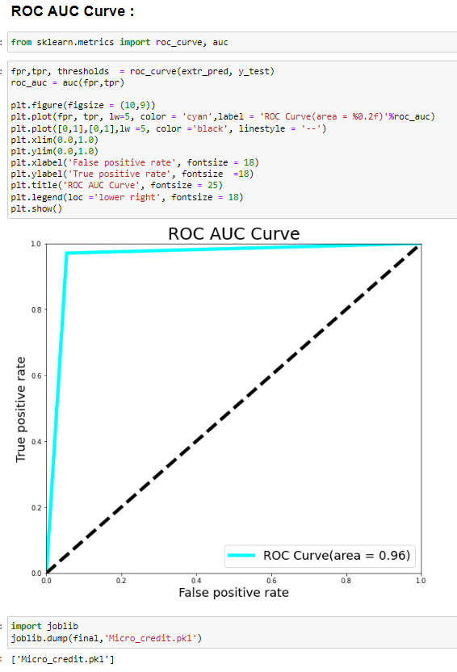
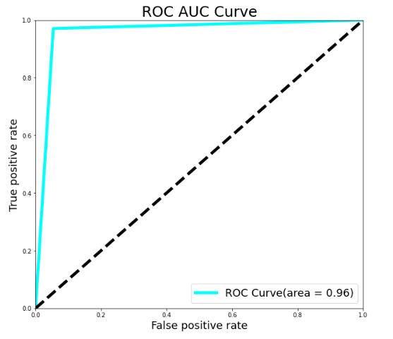


Slide 37
Conclusion
I have built a model, I have used multiple models but the highest score that I have received is of Extra Trees Classifier model. So, this is the best model for predicting the values here.
I have made box plot, so from their I come to know that there were a lot of outliers present, So, I have treated them as well as.
In the dataset there was the problem of skewness that I have observed, So I have treated them also.
These are the keys which are used for model prediction of our dataset: -
Average precision is 0.96, F1 Score is 0.96 and ROC – AUC Score is also 0.958

Slide 38
Limitations and Scope
for the Future
There was Class Imbalance which had to be handled because it we don’t do that then our model would become biased, So I have to used respected functions to treat this thing and there are chances that now It may effect the model.
As there were a lot of outliers and skewness present, so data loss was also there

Slide 39


